Slide 1

Mrs.Manjurathi UR13EC236:Tozer Samuel
Assistant Professor UR13EC109:Jobin George
UR13EC173:Prince Immanuel
UR13EC214:Shyam

Slide 2

  To monitor the vehicle registration number using car monitoring system based on IOT technology for security purpose.

Slide 3

1st Review
Interfacing raspberrypi with hall sensor and 16*2 LCD for counting the cars passing by.
2nd Review
Interfacing raspberrypi with pi camera board and extracting the registration number of the vehicle from the image file.
3rd Review
Displaying licence plate number.

Slide 4

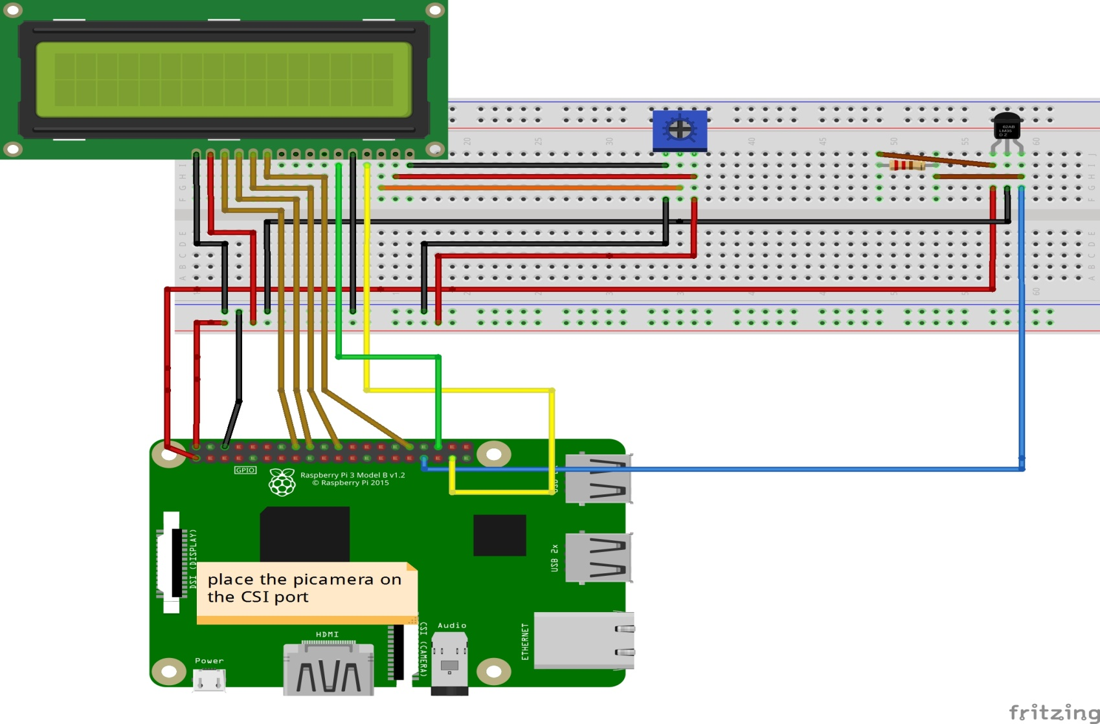

Slide 5

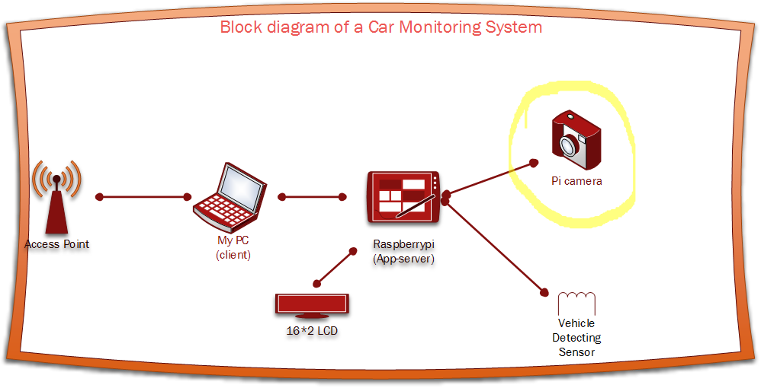

Slide 6

As a continuation we integrated picamera to the previous module, which will be initiated to take picture of the front part of the car as soon as the car passes across the magnetic sensor .
Then we read the image file from the location where it is stored while the picture was taken then we output it in the buffer.
Now we create POST payload, with a header and body, the content type of the header is application/x-www-urlformencoded and the body is in the json format.

Slide 7
Then we POST it to the url https://api.openalpr.com/v1/recognize
Since the return format is json, we will decode it using json block.
Then the results are displayed on the console as well as on the 16*2 LCD.

Slide 8

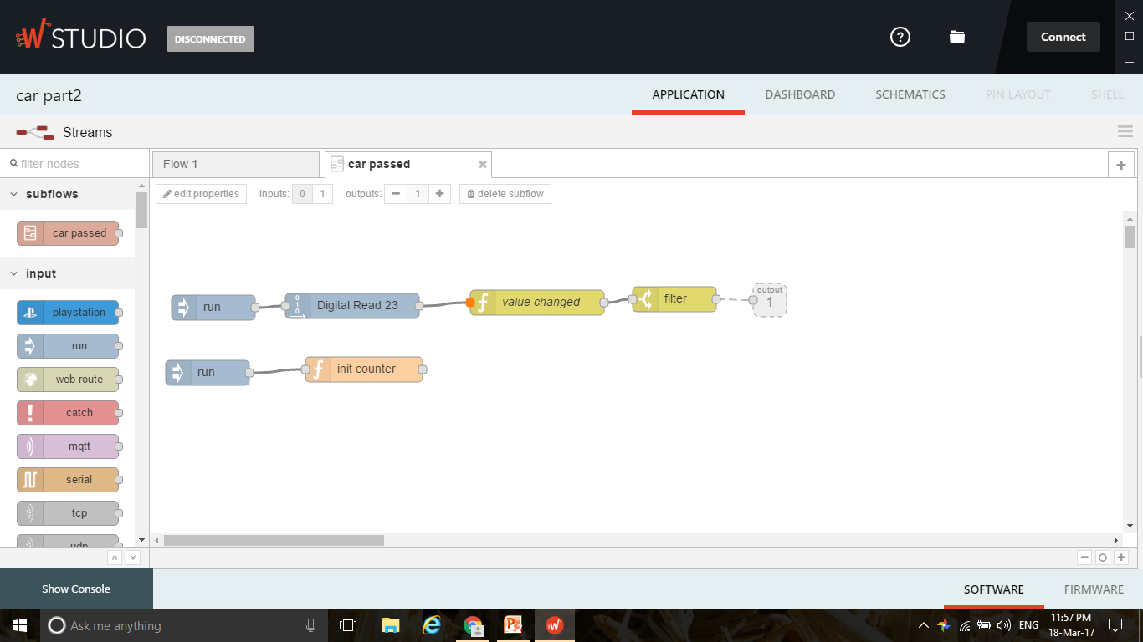

Slide 9

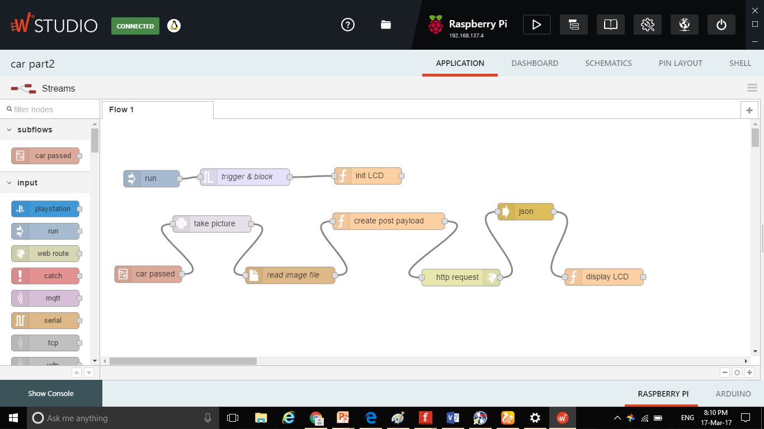

Slide 10

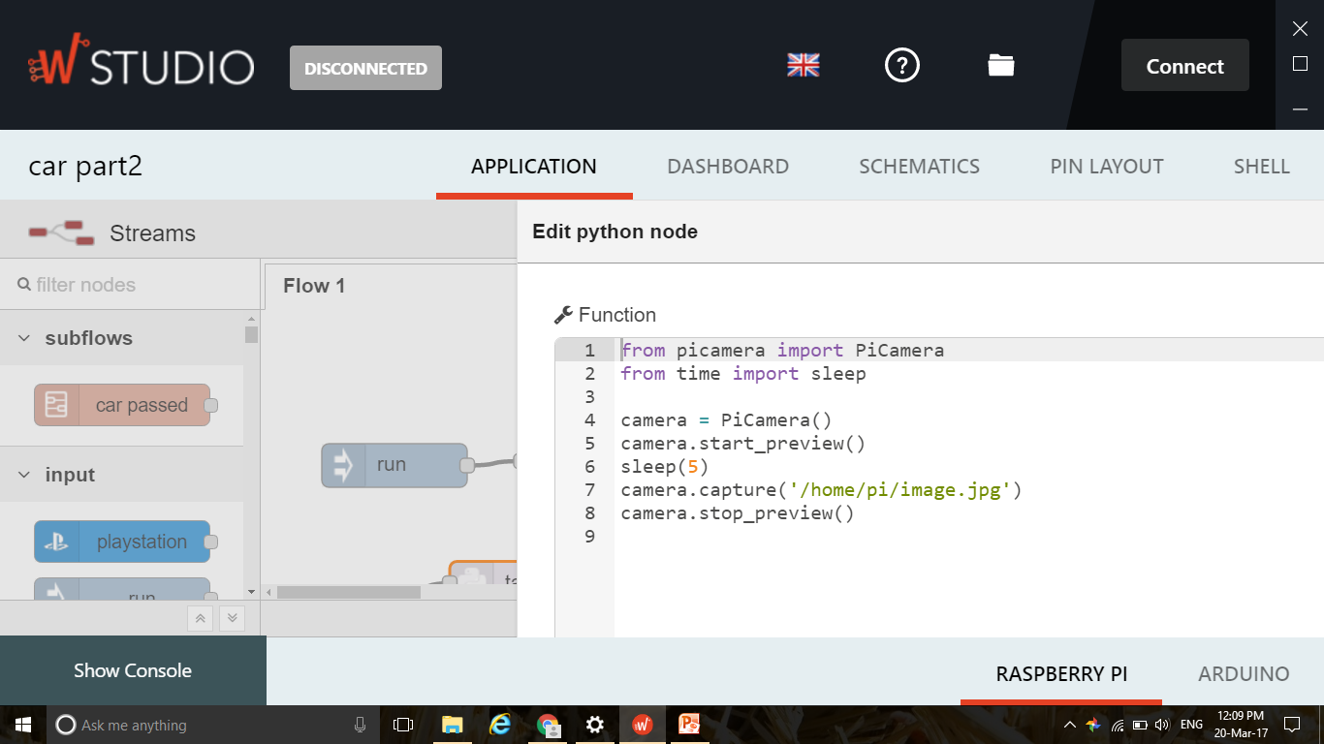

Slide 11

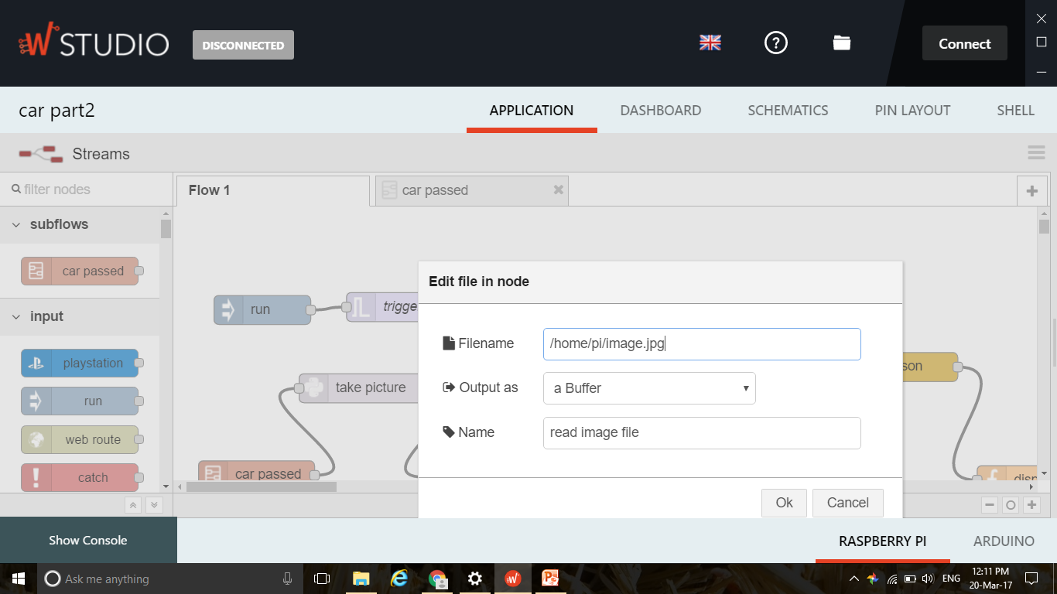

Slide 12

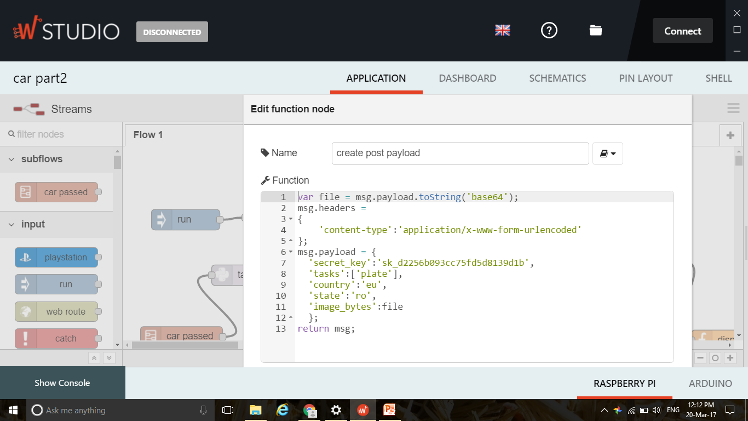

Slide 13

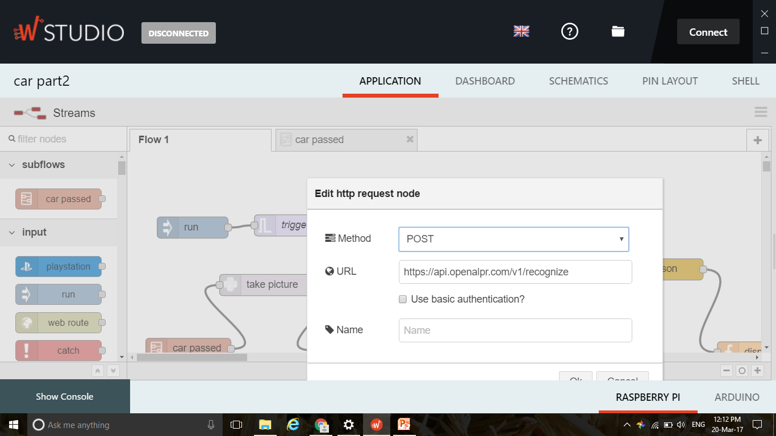

Slide 14

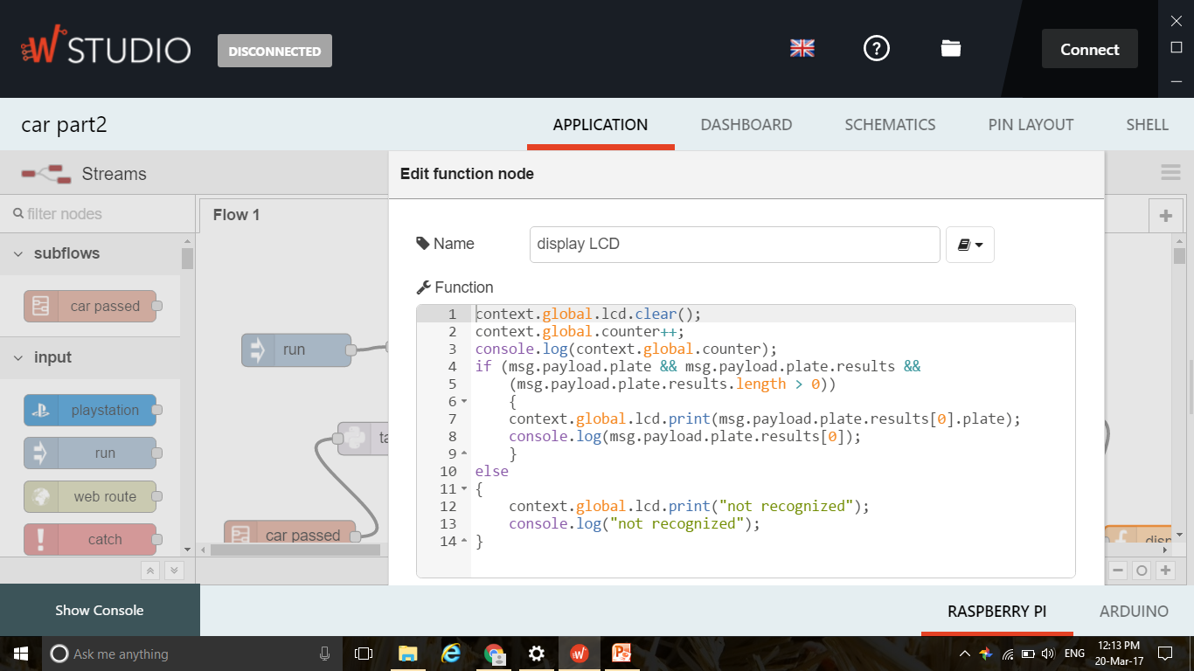

Slide 15

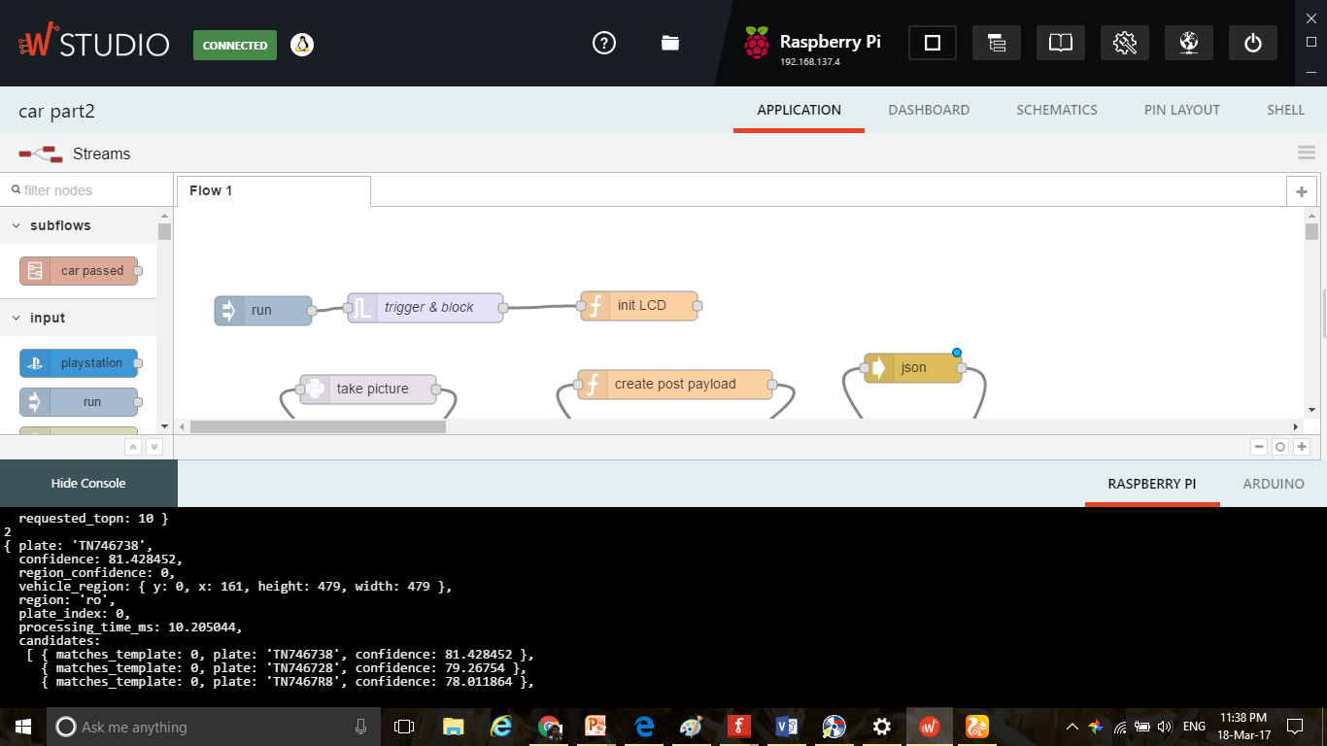

Slide 16

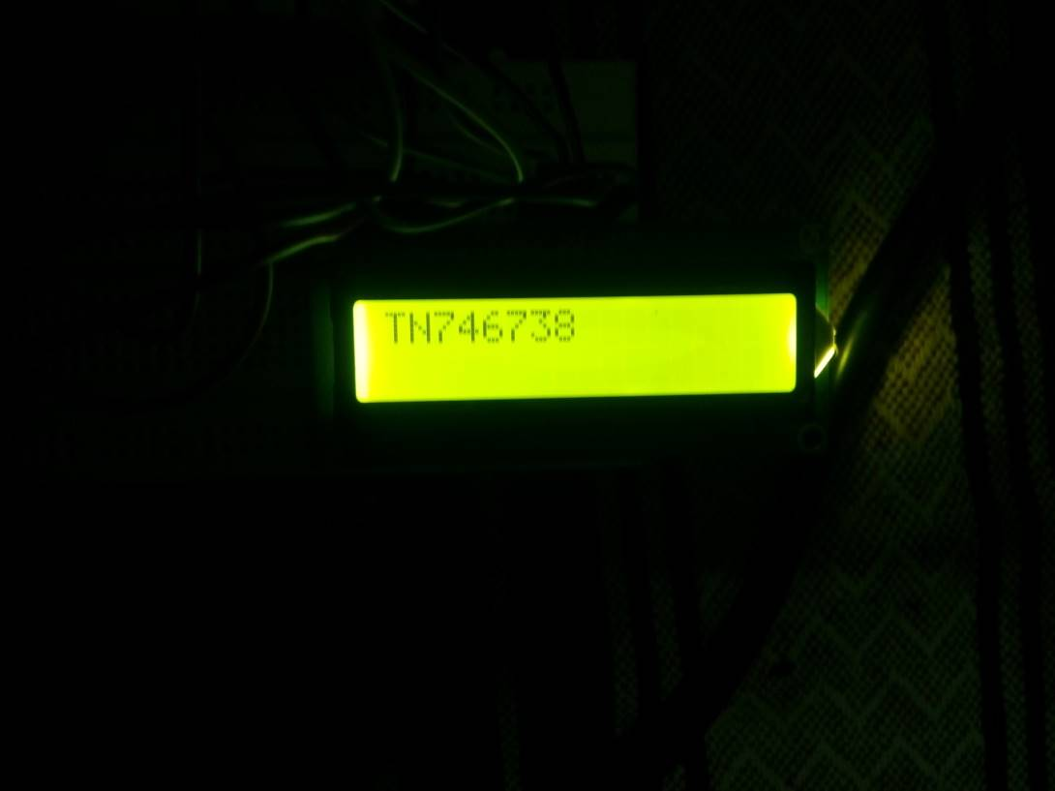

Slide 17
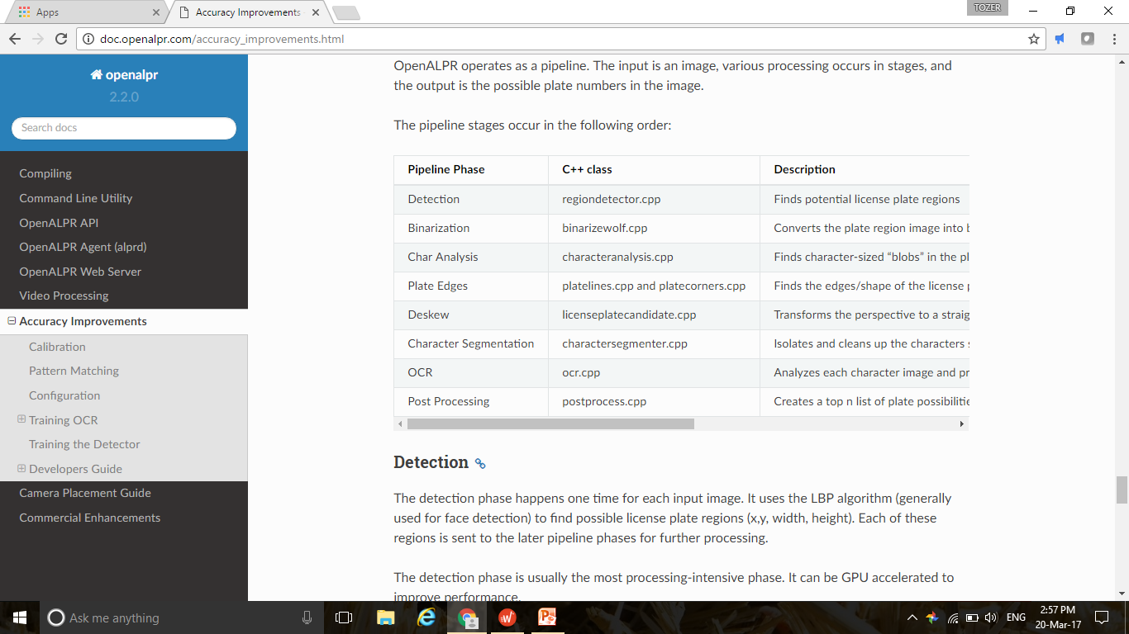

Slide 18



